Slide 1
Surface Processes Review
Weathering, Erosion, Deposition

Slide 2
Weathering: The Breakdown of Rock
A. This occurs when rocks are exposed to:
The Atmosphere(precipitation, wind, etc.) and subsurface groundwater
B. The two types of weathering are:
Physical (just mechanical break down)
Chemical (chemically altering a rock/mineral such as dissolving it.
Weathering rates are determined by:
Surface Area
Composition
Climate

Slide 3
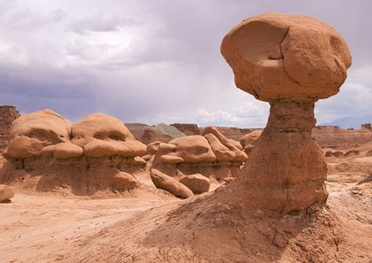
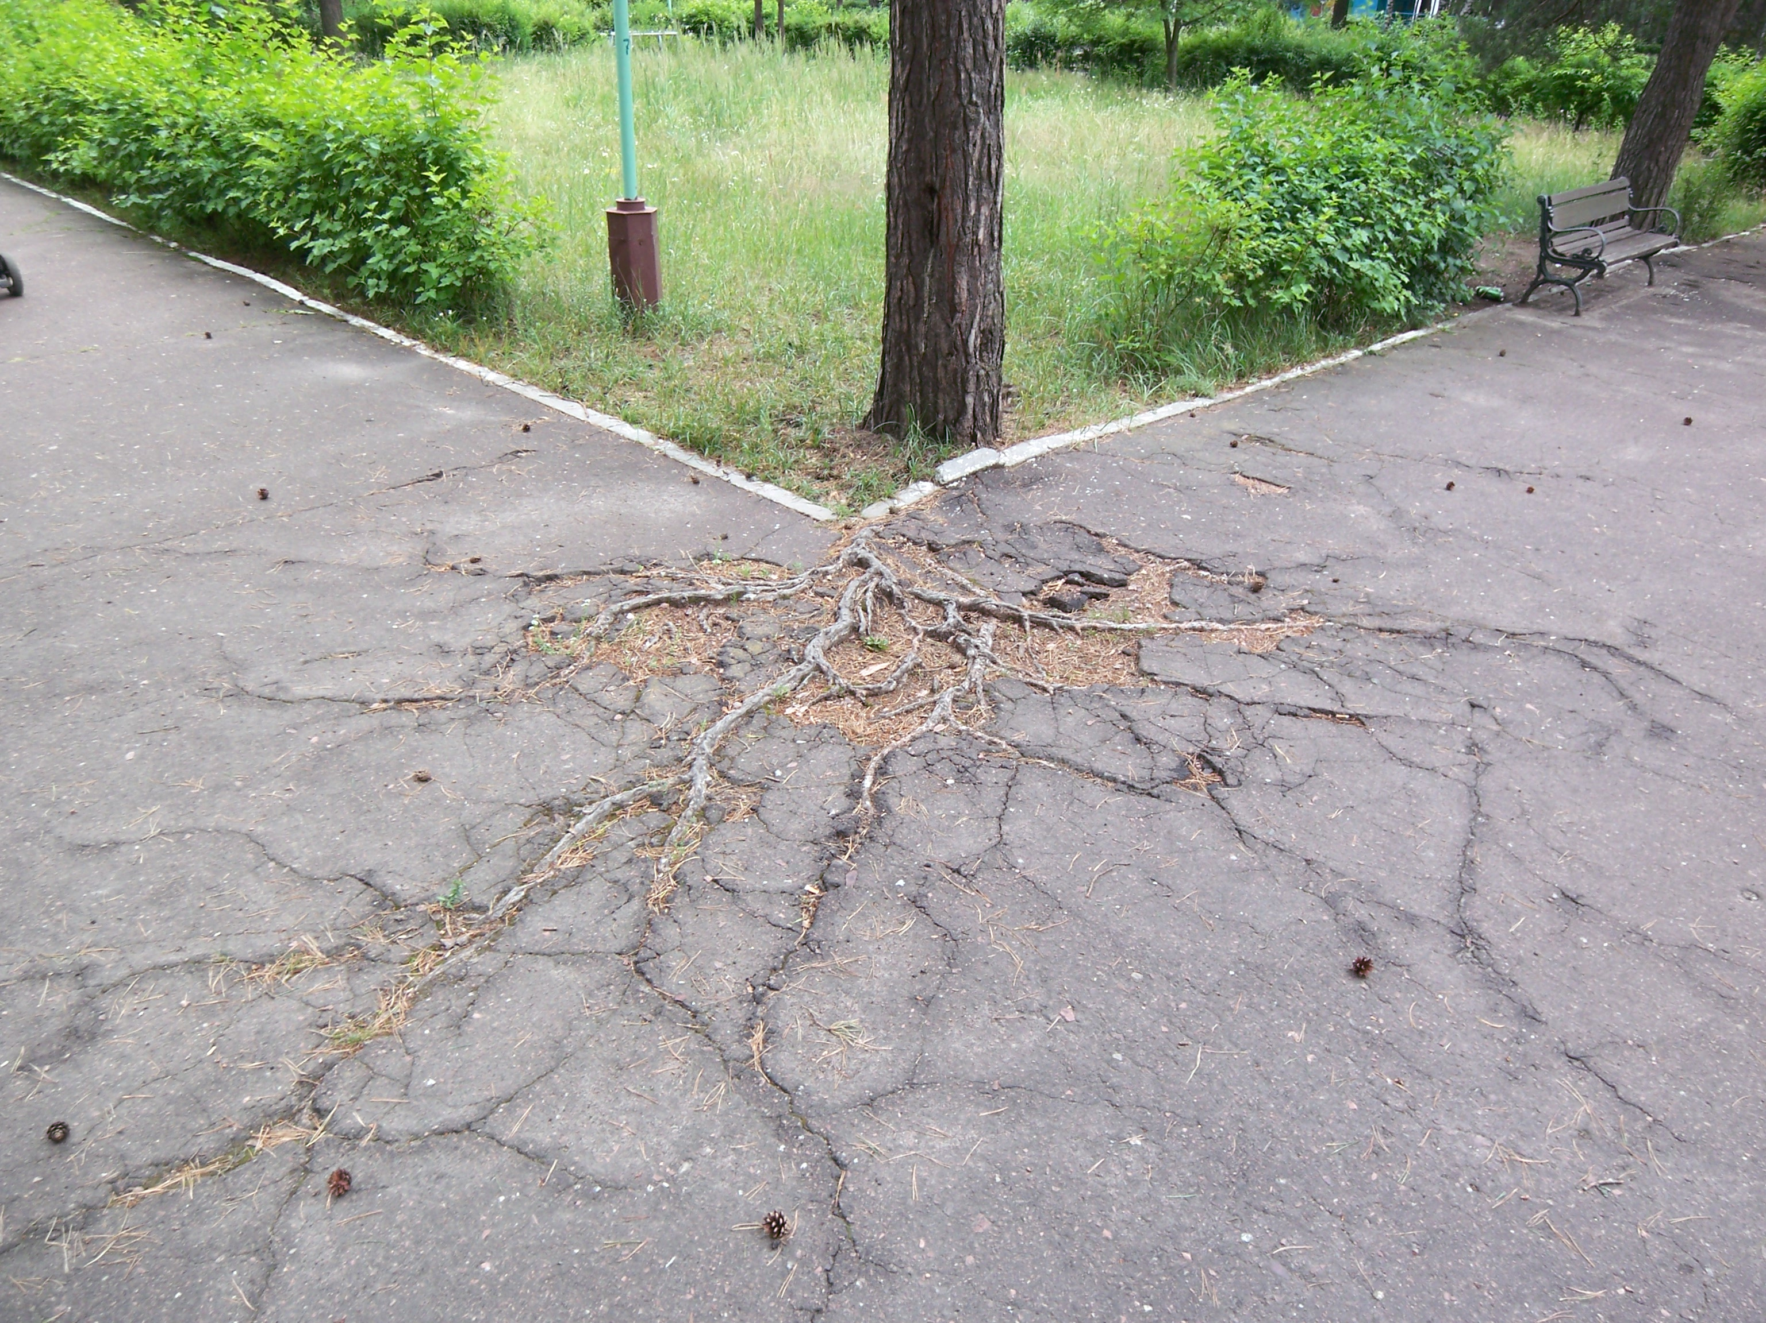
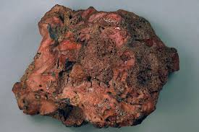
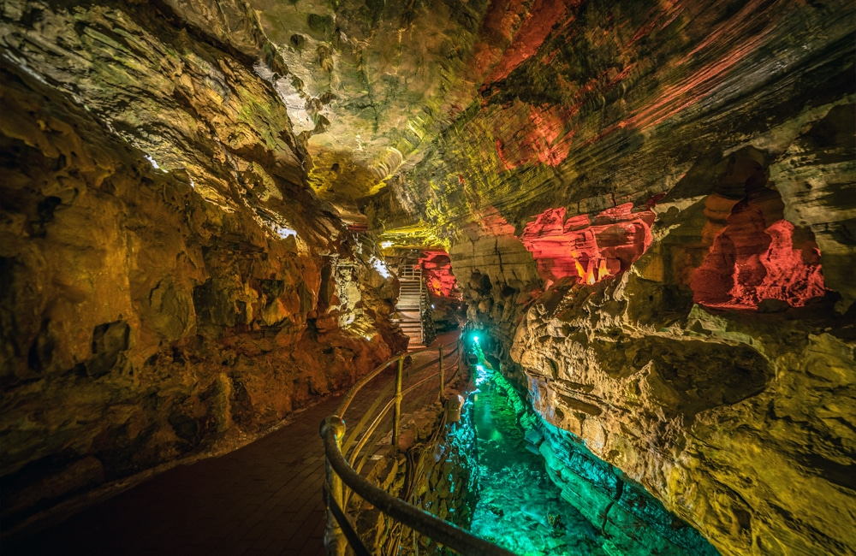
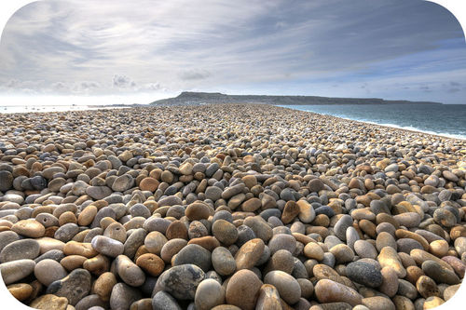
Chemical or Physical?

Slide 4
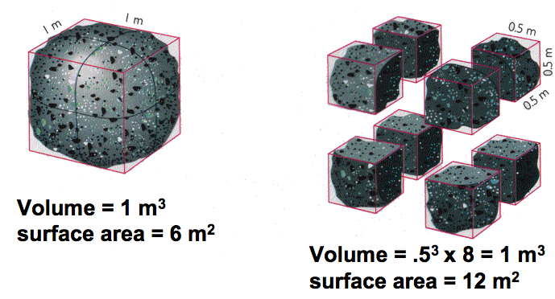
Which will weather faster?

Slide 5
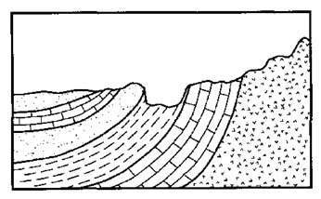
Which sedimentary layer is most and least resistant to weathering?

Slide 6
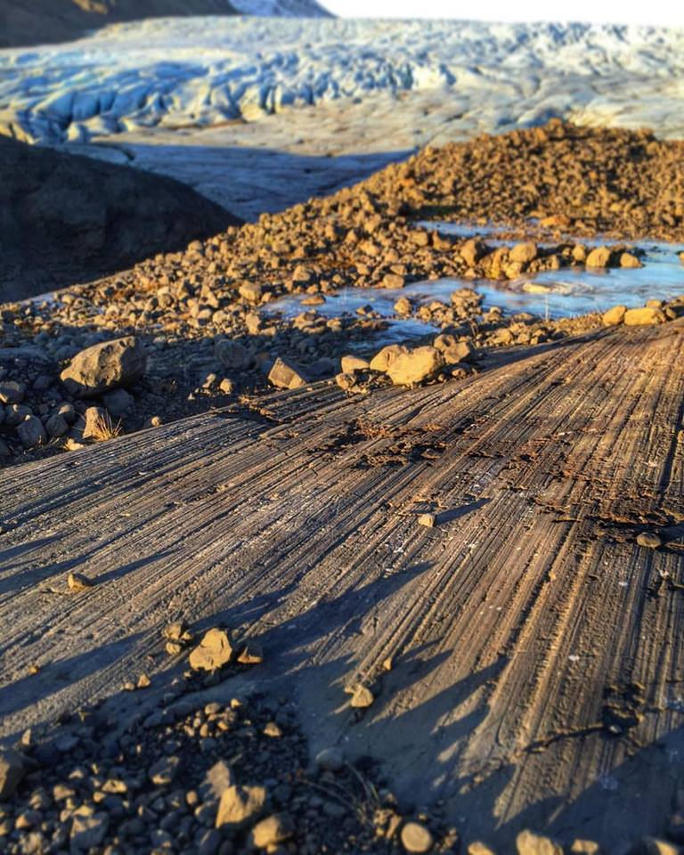
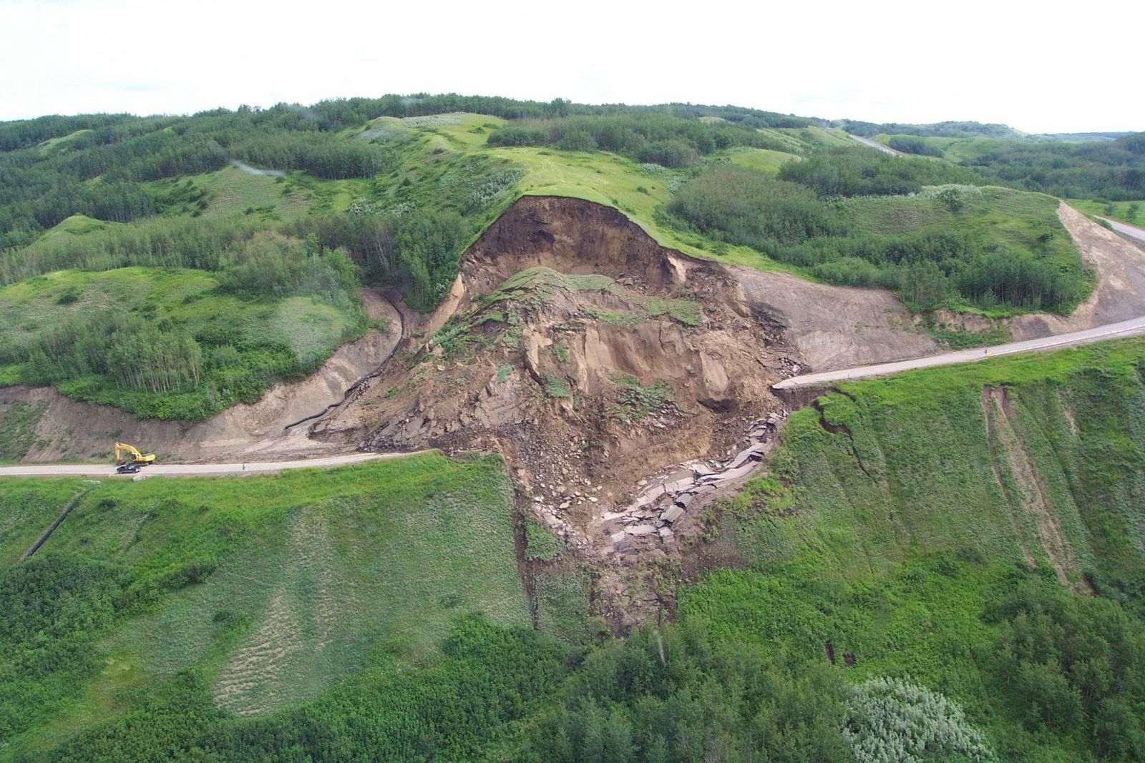
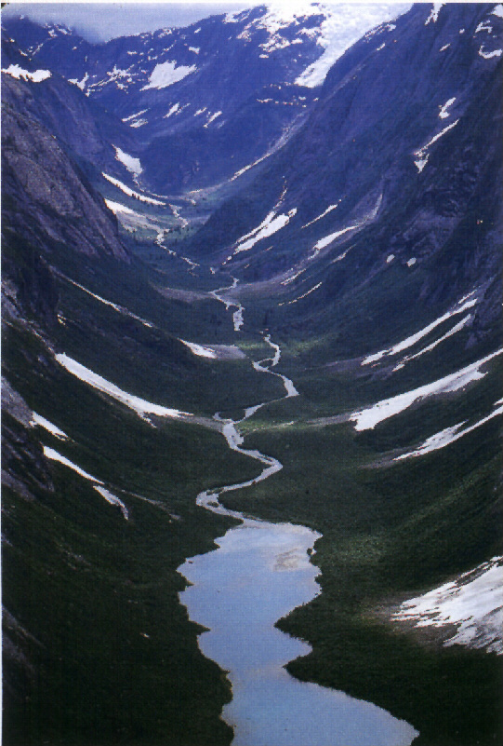
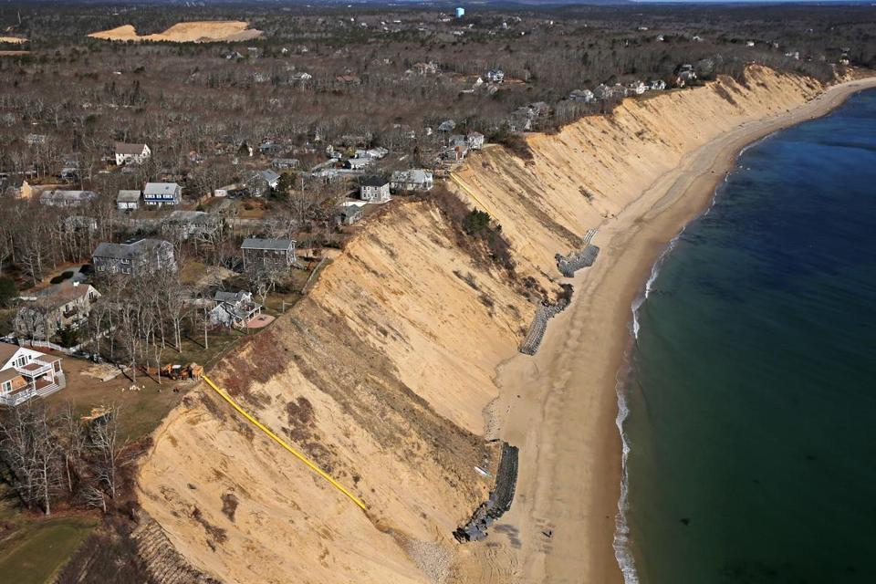
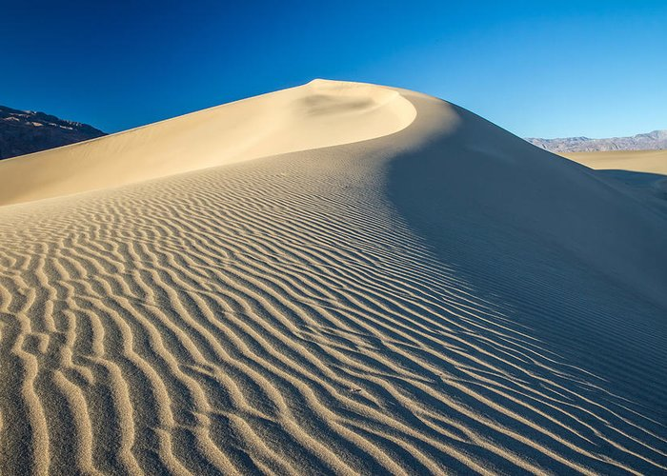
What is erosion? Which agents created the following?

Slide 7
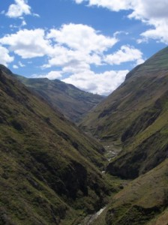
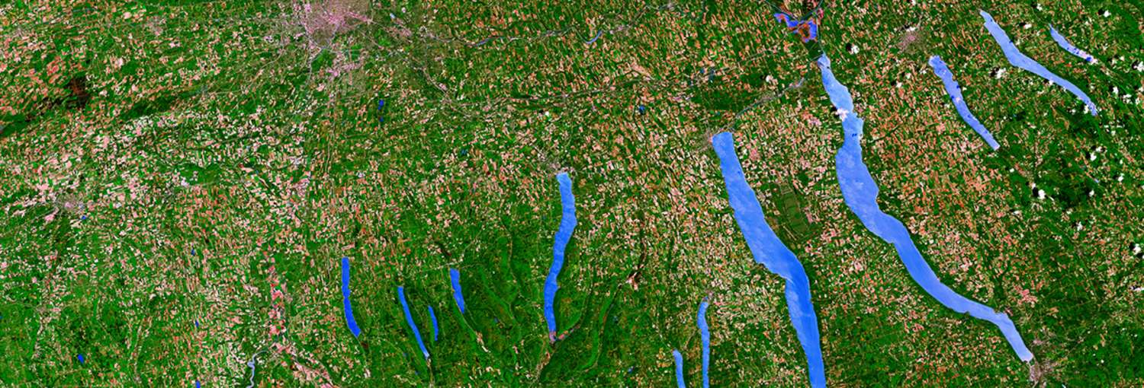
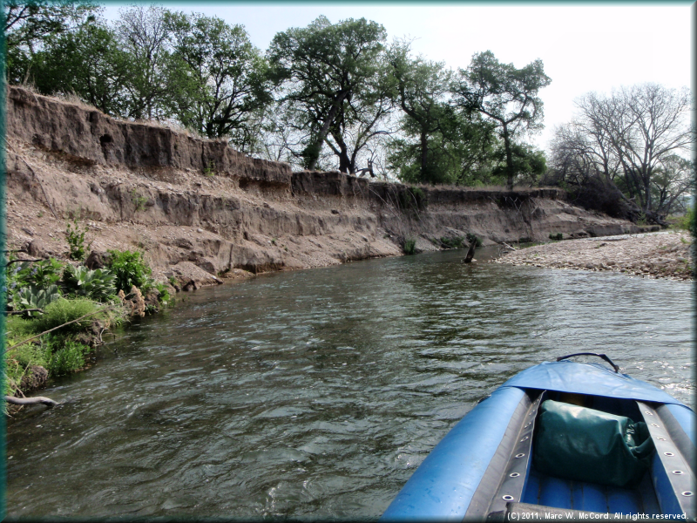
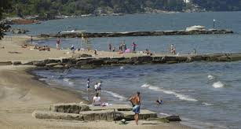

Slide 8
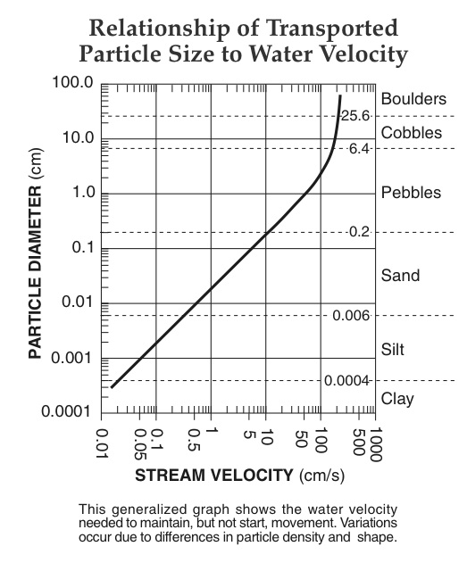
What sized sediments can be transported (eroded) at a stream velocity of 5 cm/s? If the stream velocity decreased to 0.3 cm/s which sediment would become deposited?

Slide 9
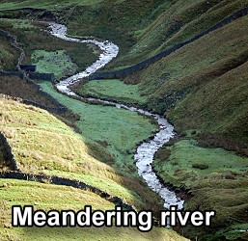
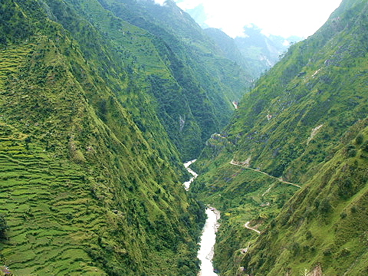
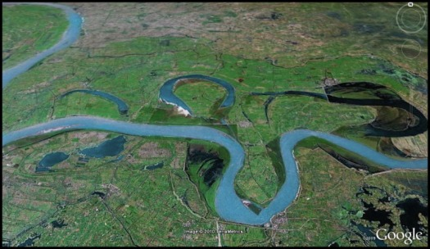
List these stream systems in order from youngest to oldest
https://i1.trekearth.com/photos/52368/kaali_river_valley.jpg

Slide 10
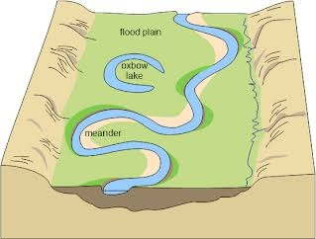
What would the profiles look like at each of the following points across the river?
1
2
3

Slide 11
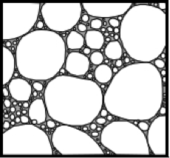
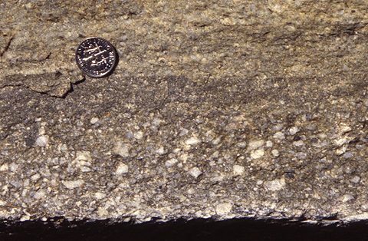
Which agents of deposition produce sorted vs. unsorted sediments?

Slide 12
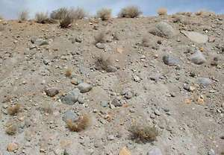
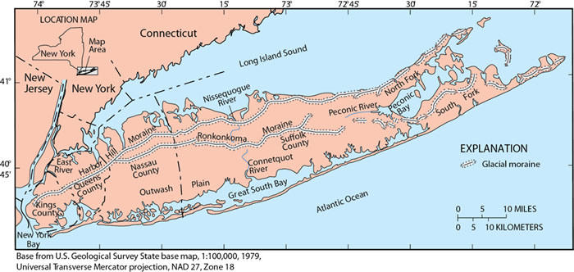
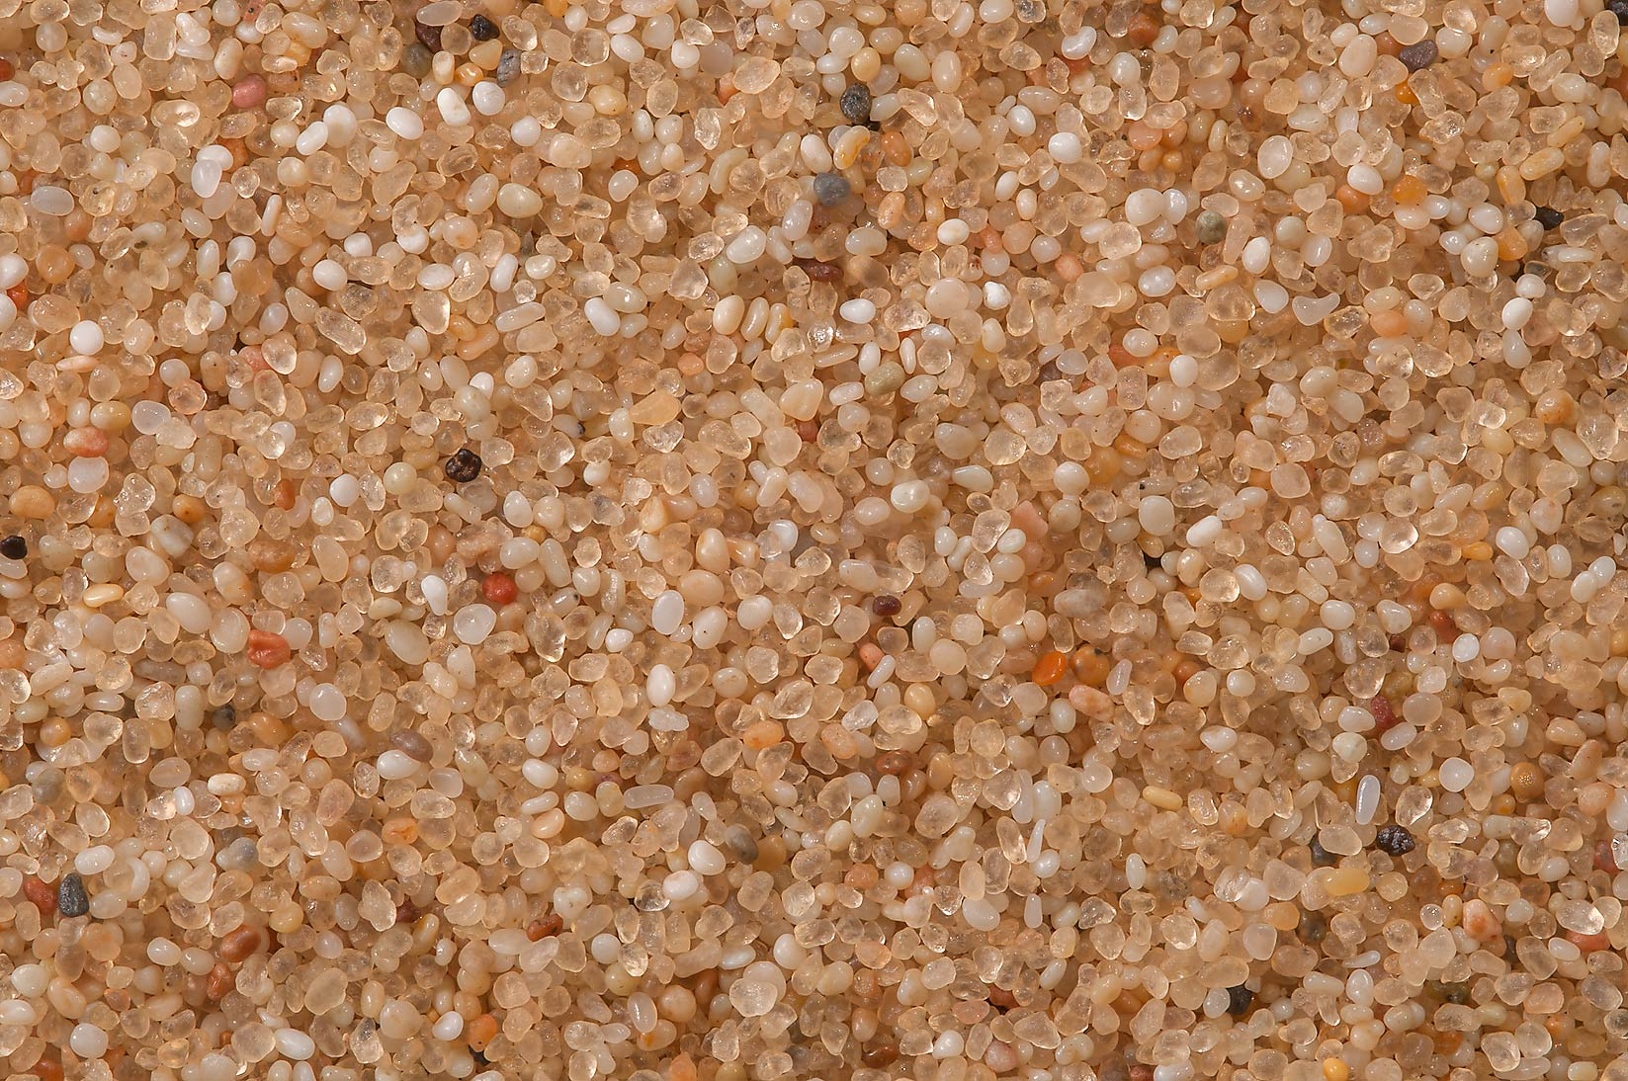
Glacial Ice (unsorted) vs. Meltwater deposition(sorted) on Long Island

Slide 13
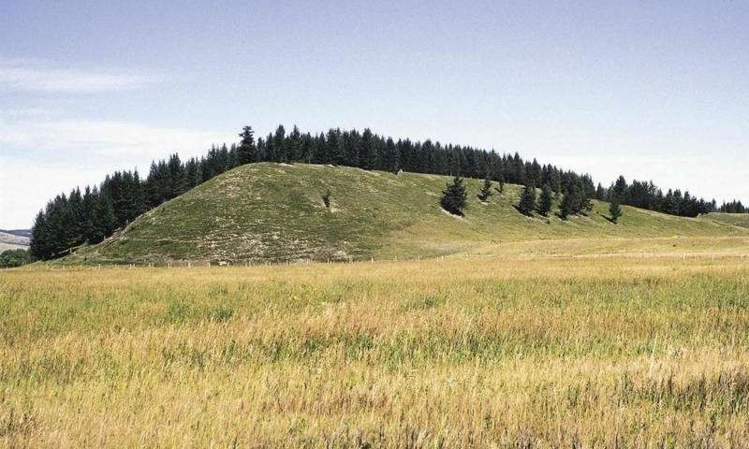
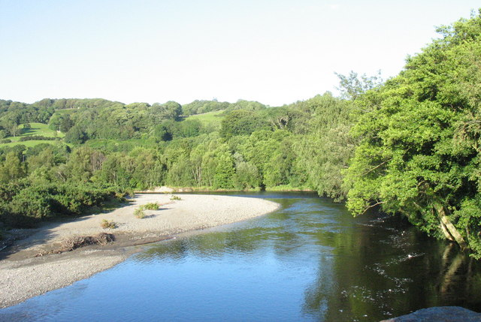
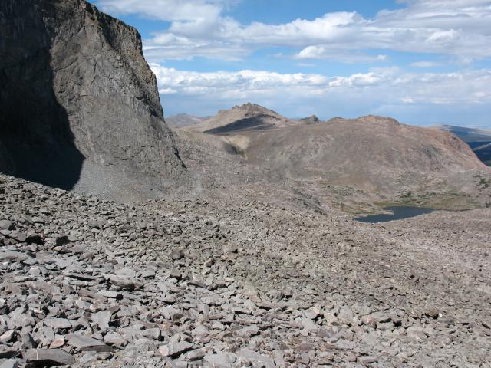
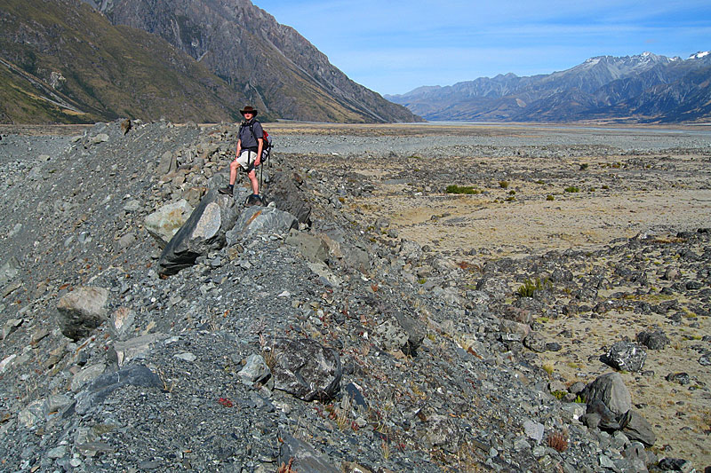
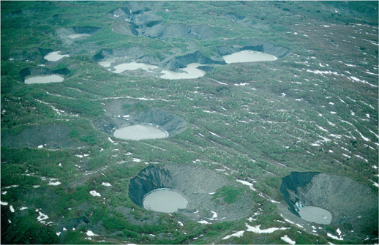
Which agents produced the following depositional features?

